Slide 1
Sensor Pod Configuration at TFRI with PRIME Week 2
Thaddeus Trinh
July 10, 2013

Slide 2
Proposed Research
To work with TFRI to help integrate new sensors into their Android sensor pod network and to deploy and test the new sensors in the field
Fuel Moisture Sensor
Solar Irradiation Sensor
Soil Moisture Sensor
Soil Drainage Gauge

Slide 3
Progress (Week 2)
Completed the UCSD-TFRI Sensor Pod Data Turbine Workshop
Helped teach a workshop course on soldering, setting up the Sensor Pod hardware, downloading the Sensor Pod source code, and making modifications to the source code
Received the Soil moisture sensor, soil drainage gauge, and the CTD Sensor

Slide 4
Sensors
CTD
Electrical Conductivity, Temperature and Depth Sensor
Drain Gauge Model G3
10HS Soil Moisture Sensor
Fuel Stick
Kipp Zonnen Solar Irradiation Sensor
Finished reading the documentation on all five sensors and have finished adding the android code to monitor the Fuel Stick and the Solar Irradiation Sensor
Having problems connecting the Fuel Stick to the sensor pod
Still need to find a proper female connector for the fuel stick, until then I am just improvising by loosely connecting cables to each of the male ends of the wire
Low readings from the sensor could be because of not having the proper connector or sensor could be broken

Slide 5
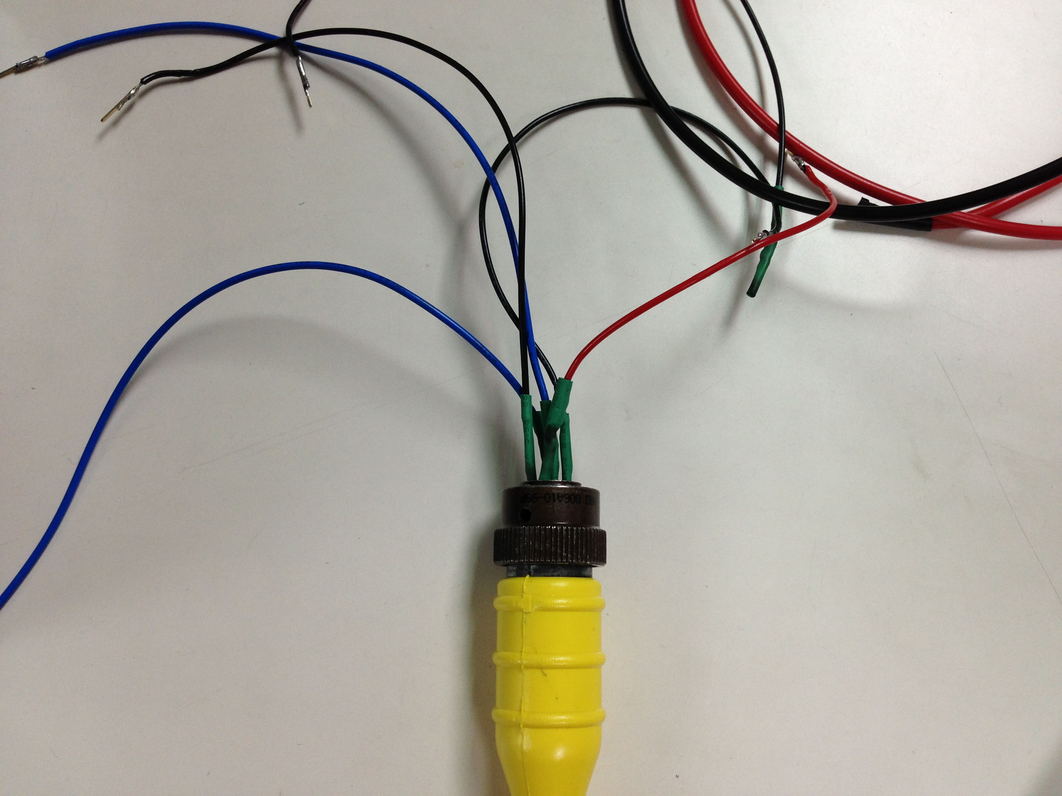
Fuel Stick Connector

Slide 6
Upcoming Goals
Continue modifying the code to add capabilities for the three new sensors
Find a proper way to connect the male end of the fuel stick to the Android sensor pod

Slide 7
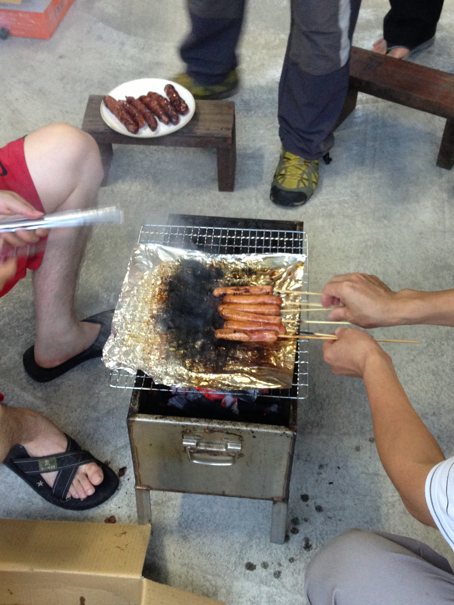
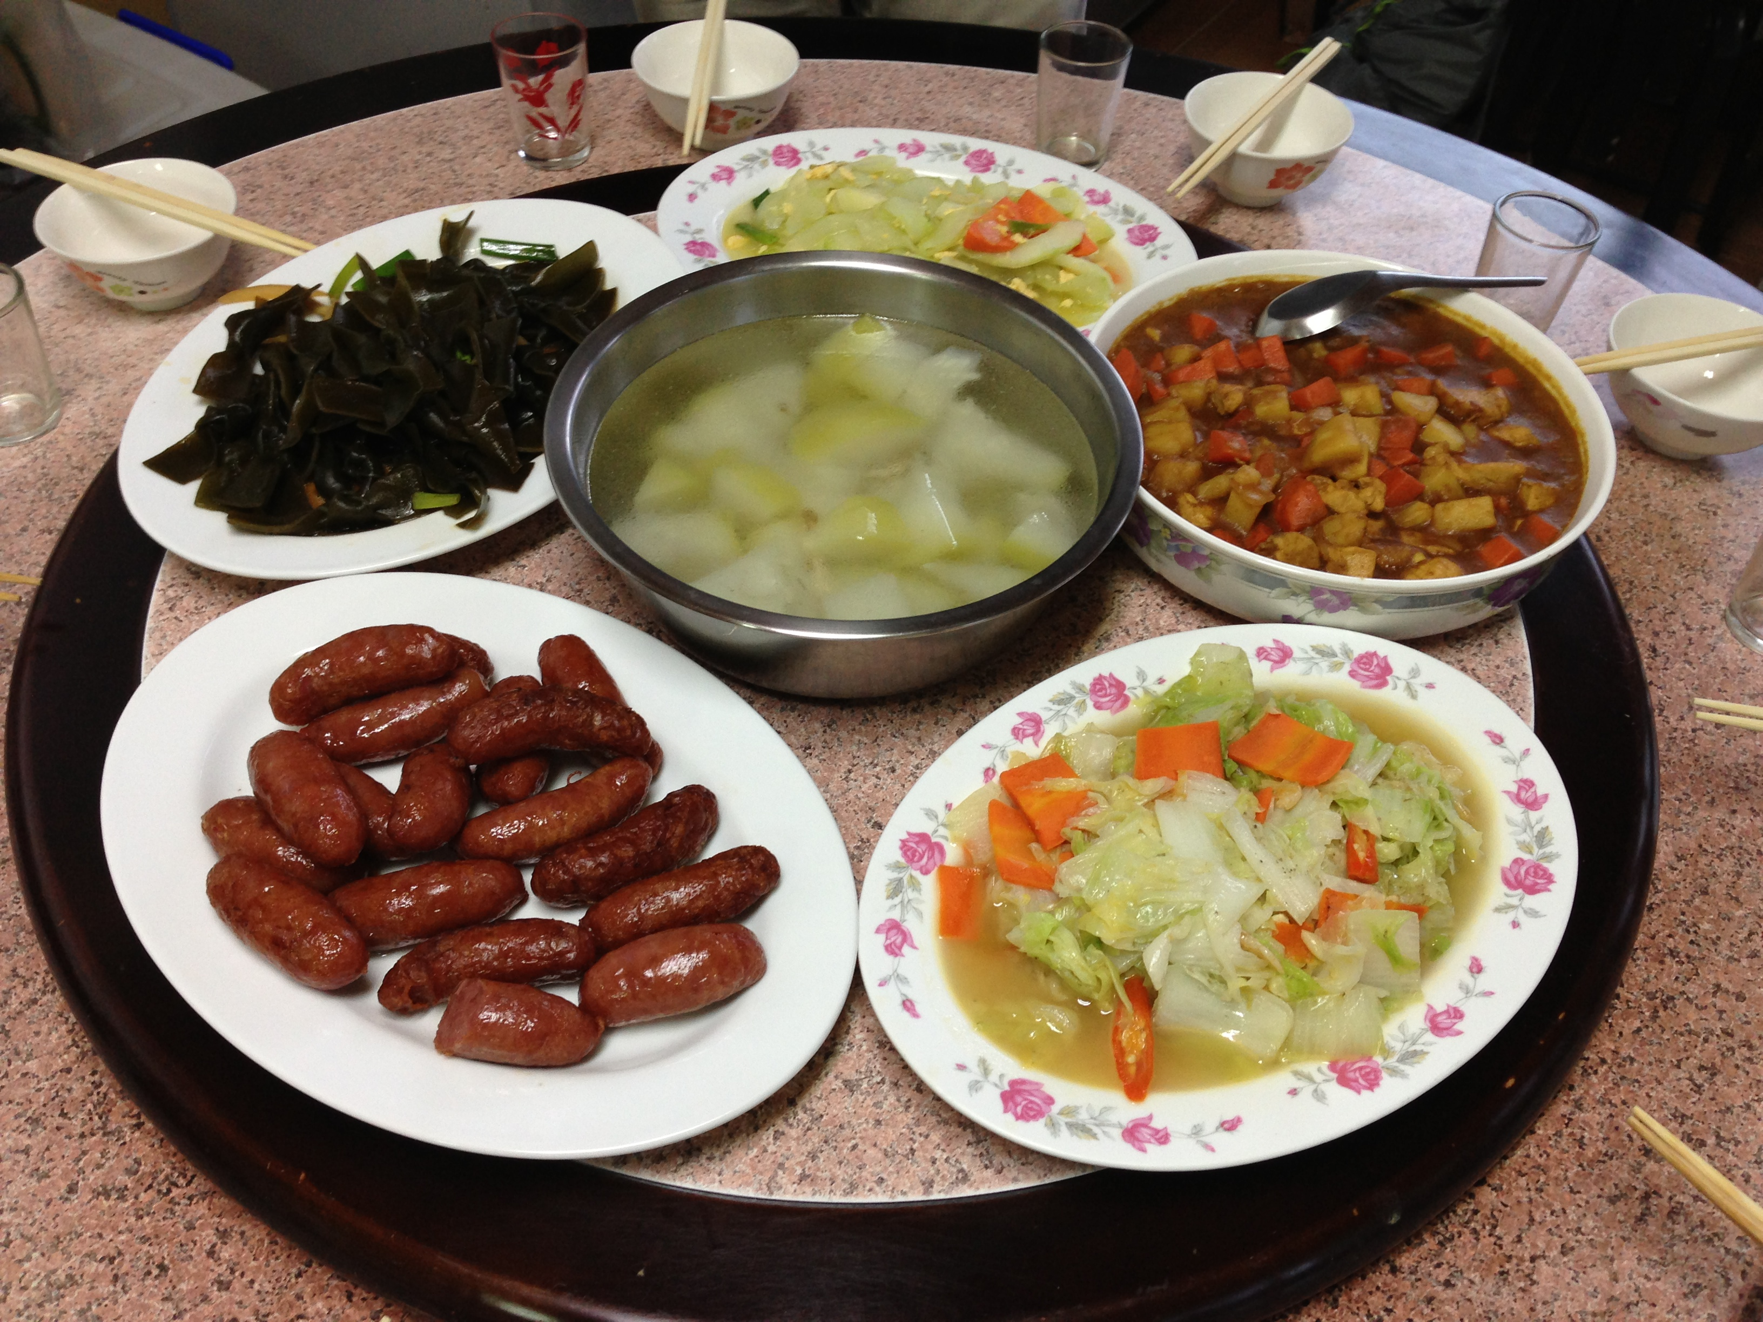
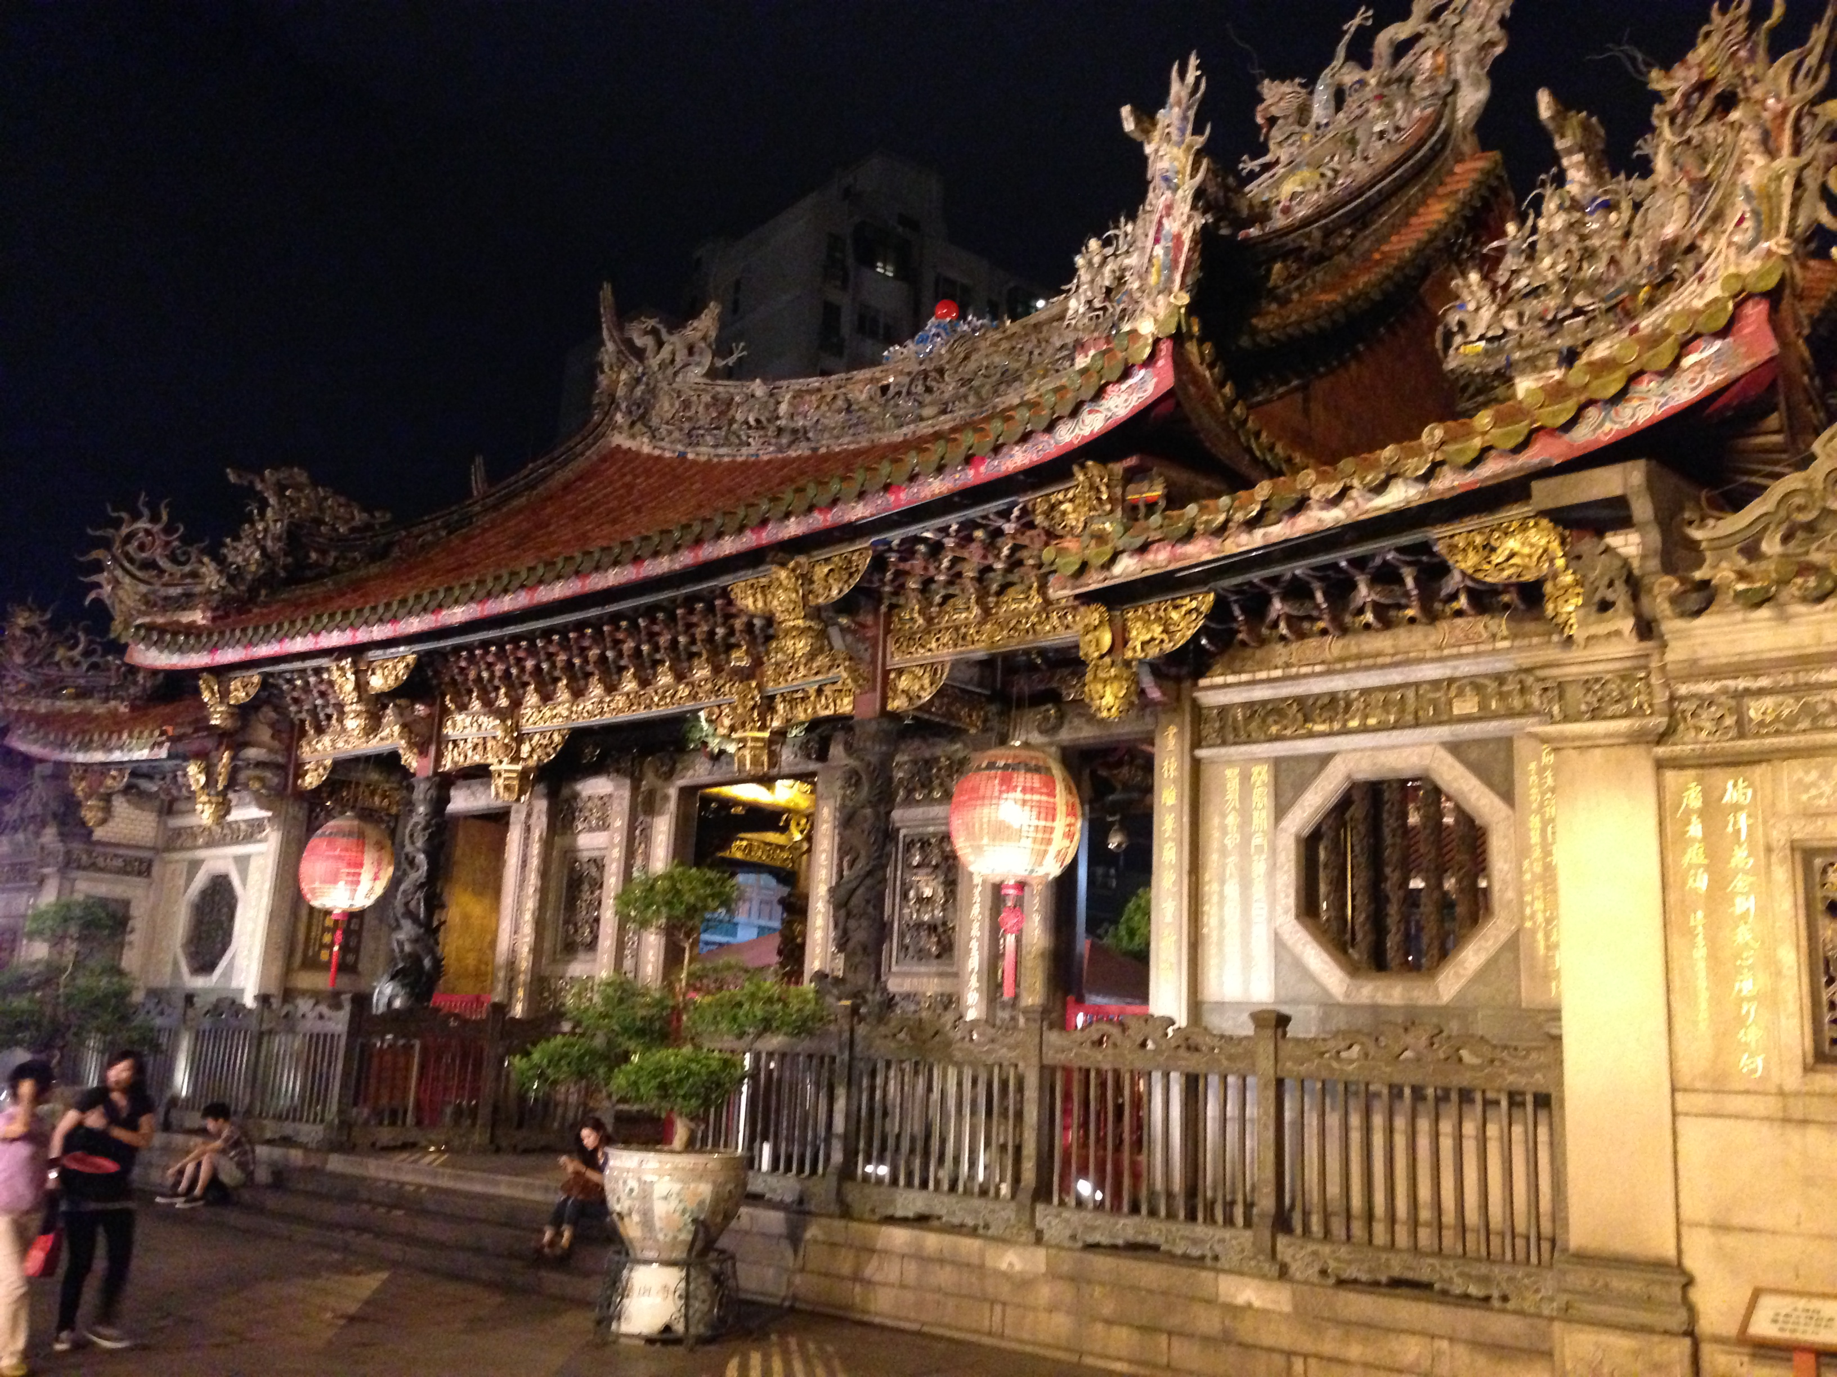
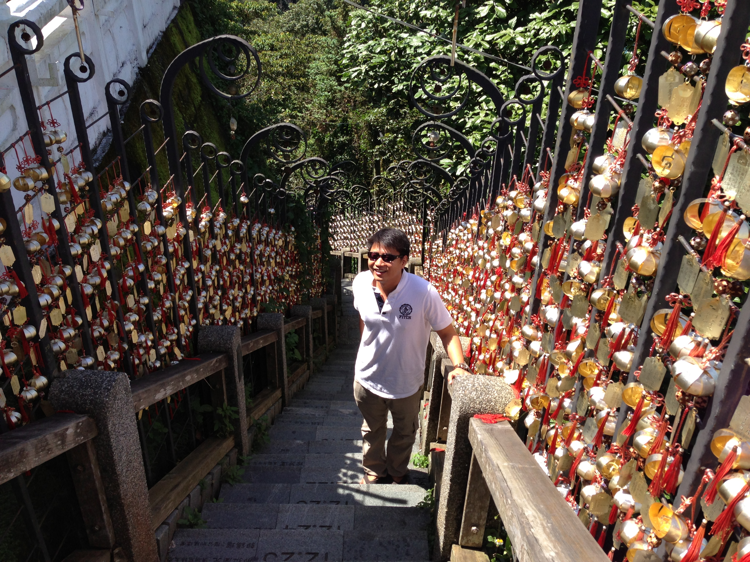
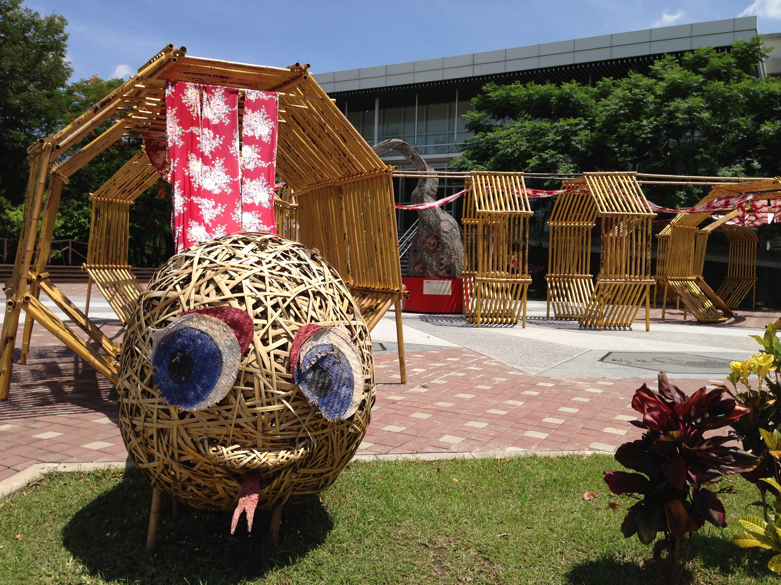
Culture
Left to right: Workshop meals, Taiwanese BBQ, Longshan Temple, Peter at Sun Moon Lake, a Bamboo snake

Slide 8
Acknowledgements
Mentors
Tony Fountain (CALIT2)
Chau Chin Lin (TFRI)
Sheng-Shan Lu (TFRI)
Yu-Huang Wang (TFRI)
Peter Shin (CALIT2)
PRIME
Peter Arzberger
Gabriele Wienhausen
Teri Simas
Tricia Taylor

